Slide 1
Chapter 1
Introduction

Slide 2
Basic Definitions
Database: A collection of related data.
Data: Known facts that can be recorded and have an implicit meaning.
Database Management System (DBMS): A software package/ system to facilitate the creation and maintenance of a computerized database.

Slide 3
Types of Databases and Database Applications
Numeric and Textual Databases
Multimedia Databases
Geographic Information Systems (GIS)
Data Warehouses
Real-time and Active Databases

Slide 4
File processing system vs DBMS
File processing system | DBMS
Redundancies and inconsistencies exist | Redundancies and inconsistencies are reduced
Data cannot be easily accessed due to complex application programs to access data | Data can be easily accessed due to query processor
Data isolation is difficult because of different file formats | Data isolation is easier because of common file formats
Integrity constrains cannot be added easily because again new application programs have to be written | Integrity constraints can be added easily at any time
Security features cannot be added easily | Security features can be added easily
Concurrent access may cause problem of inconsistencies | Concurrent accesses are possible without any inconsistencies

Slide 5
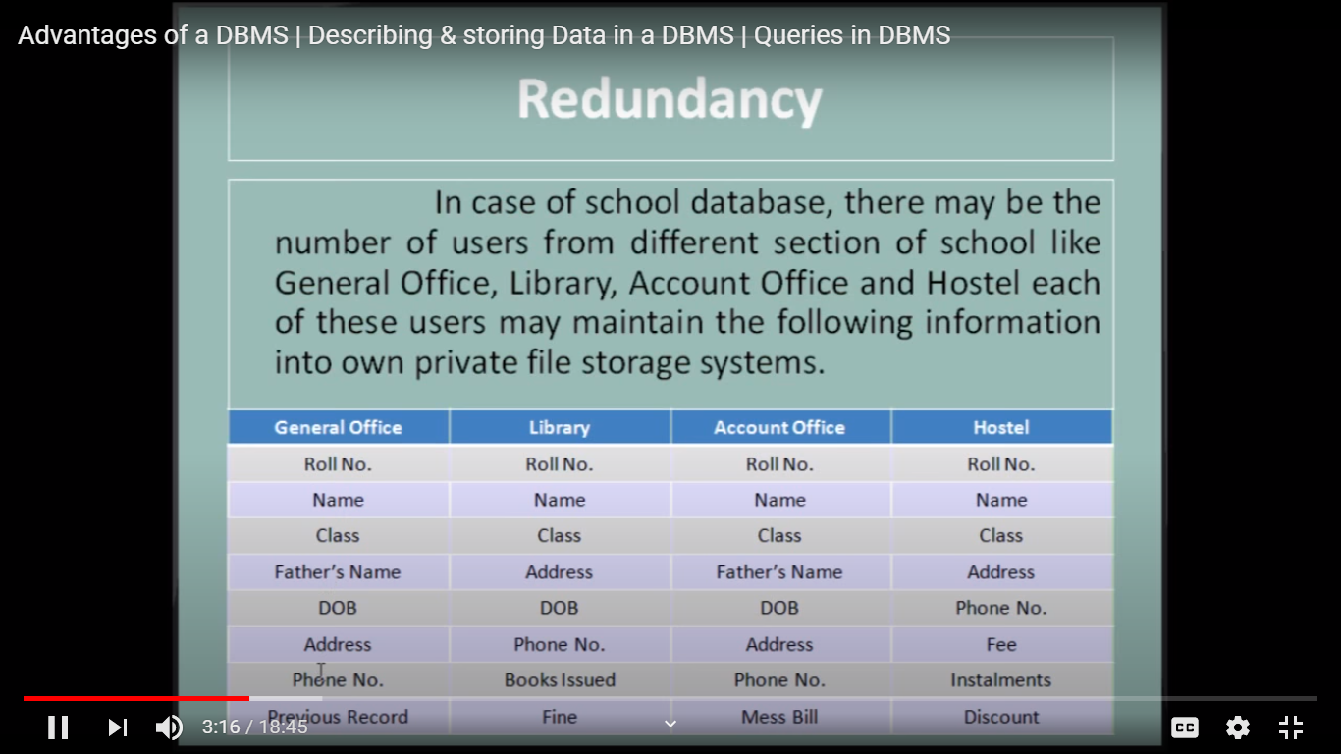

Slide 6
Database Users
Users may be divided into those who actually use and control the content

Slide 7
Database Users
Database administrators: responsible for authorizing access to the database, for co-ordinating and monitoring its use, acquiring software, and hardware resources, controlling its use and monitoring efficiency of operations.
Database Designers: responsible to define the content, the structure, the constraints, and functions or transactions against the database. They must communicate with the end-users and understand their needs.
End-users: they use the data for queries, reports and some of them actually update the database content.

Slide 8
Database Users:
Users are differentiated by the way they expect to interact with the system:
Application programmers:
Application programmers are computer professionals who write application programs. Application programmers can choose from many tools to develop user interfaces.
Rapid application development (RAD) tools are tools that enable an application programmer to construct forms and reports without writing a program.
Sophisticated users:
Sophisticated users interact with the system without writing programs. Instead, they form their requests in a database query language.
They submit each such query to a query processor, whose function is to break down DML statements into instructions that the storage manager understands.
Specialized users :
Specialized users are sophisticated users who write specialized database applications that do not fit into the traditional data-processing framework.
Among these applications are computer-aided design systems, knowledge base and expert systems, systems that store data with complex data types (for example, graphics data and audio data), and environment-modeling systems.
Naïve users :
Naive users are unsophisticated users who interact with the system by invoking one of the application programs that have been written previously.
For example, a bank teller who needs to transfer $50 from account A to account B invokes a program called transfer. This program asks the teller for the amount of money to be transferred, the account from which the money is to be transferred, and the account to which the money is to be transferred.

Slide 9
Database Administrator:
Coordinates all the activities of the database system. The database administrator has a good understanding of the enterprise’s information resources and needs.
Database administrator's duties include:
Schema definition: The DBA creates the original database schema by executing a set of data definition statements in the DDL.
Storage structure and access method definition.
Schema and physical organization modification: The DBA carries out changes to the schema and physical organization to reflect the changing needs of the organization, or to alter the physical organization to improve performance.
Granting user authority to access the database: By granting different types of authorization, the database administrator can regulate which parts of the database various users can access.
Specifying integrity constraints.
Monitoring performance and responding to changes in requirements.

Slide 10
Advantages of Using the Database Approach
Controlling redundancy in data storage and in development and maintenance efforts.
Sharing of data among multiple users.
Restricting unauthorized access to data.
Providing Storage Structures for efficient Query Processing

Slide 11
Advantages of Using the Database Approach
Providing backup and recovery services.
Providing multiple interfaces to different classes of users.
Representing complex relationships among data.
Enforcing integrity constraints on the database.
Drawing Inferences and Actions using rules

Slide 12
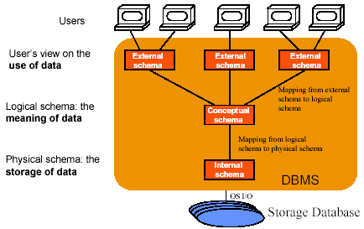
Three Schema Architecture

Slide 13
Three-Schema Architecture
Defines DBMS schemas at three levels:
Internal schema at the internal level to describe physical storage structures and access paths. Typically uses a physical data model.
Conceptual schema at the conceptual level to describe the structure and constraints for the whole database for a community of users. Uses a conceptual or an implementation data model.
External schemas at the external level to describe the various user views. Usually uses the same data model as the conceptual level.

Slide 14
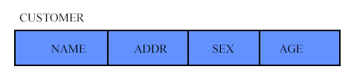
Conceptual Schema
Describes the Meaning of Data in the Universe of Discourse
Emphasizes on General, Conceptually Relevant, and Often Time Invariant Structural Aspects of the Universe of Discourse
Excludes the Physical Organization and Access Aspects of the Data

Slide 15
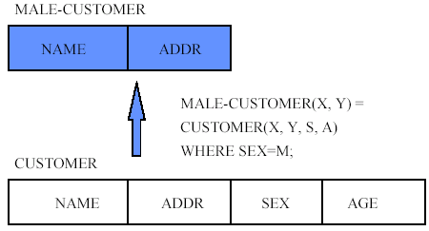
External Schema
Describes Parts of the Information in the Conceptual Schema in a form Convenient to a Particular User Group’s View
Derived from the Conceptual Schema

Slide 16
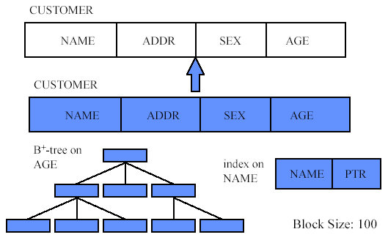
Internal Schema
Describes How the Information Described in the Conceptual Schema is Physically Represented in a Database to Provide the Overall Best Performance

Slide 17
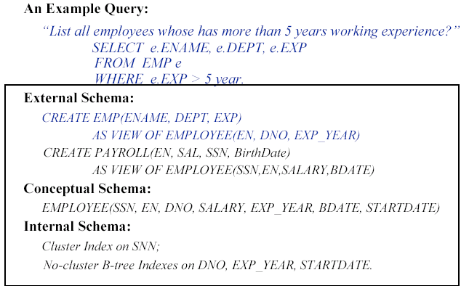
Unified Example of Three Schemas

Slide 18
Data Independence
Ability that Allows Application Programs Not Being Affected by Changes in Irrelevant Parts of the Conceptual Data Representation, Data Storage Structure and Data Access Methods
Invisibility (Transparency) of the Details of Entire Database Organization, Storage Structure and Access Strategy to the Users

Slide 19
Data Independence
Logical Data Independence: The capacity to change the conceptual schema without having to change the external schemas and their application programs.
Physical Data Independence: The capacity to change the internal schema without having to change the conceptual schema.

Slide 20
Data Independence
When a schema at a lower level is changed, only the mappings between this schema and higher-level schemas need to be changed in a DBMS that fully supports data independence. The higher-level schemas themselves are unchanged. Hence, the application programs need not be changed since they refer to the external schemas.

Slide 21
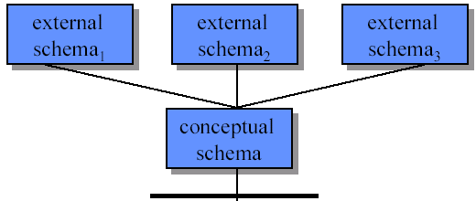
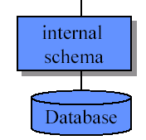
Physical Data Independence
Physical

Slide 22
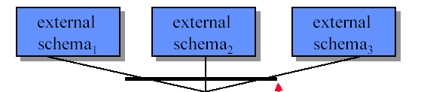
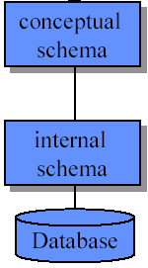
Logical Data Independence
Logical

Slide 23
Characteristics of the Database
Self-describing nature of a database system: A DBMS catalog stores the description of the database. The description is called meta-data. This allows the DBMS software to work with different databases.
data independence. Allows changing data storage structures and operations without having to change the DBMS access programs.

Slide 24
Main Characteristics of the Database Approach
Data Abstraction: A data model is used to hide storage details and present the users with a conceptual view of the database.
Support of multiple views of the data: Each user may see a different view of the database, which describes only the data of interest to that user.

Slide 25
Main Characteristics of the Database Approach
Sharing of data and multiuser transaction processing : allowing a set of concurrent users to retrieve and to update the database. Concurrency control within the DBMS guarantees that each transaction is correctly executed or completely aborted.

Slide 26
Client-Server Architectures
Servers:
Specialized Servers with Specialized functions
Ex. Database Server, File Server, Web Server, Email Server

Slide 27
Client-Server Architectures
Client:
Provide appropriate interfaces and a client-version of the system to access and utilize the server resources.
Clients maybe diskless machines or PCs or Workstations with disks with only the client software installed.
Connected to the servers via some form of a network. (LAN: local area network, wireless network, etc.)

Slide 28
Two Tier Client-Server Architecture
User Interface Programs and Application Programs run on the client side
Interface called ODBC (Open Database Connectivity) provides an Application program interface (API) allow client side programs to call the DBMS. Most DBMS vendors provide ODBC drivers.

Slide 29
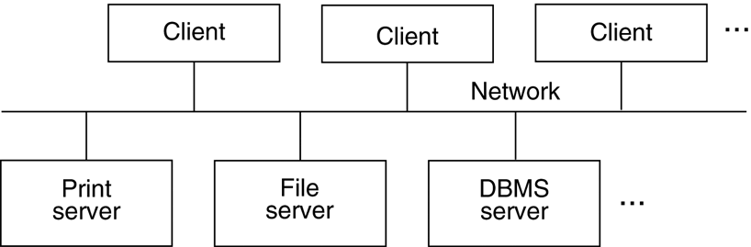
Logical two-tier client/server architecture

Slide 30
Three Tier Client-Server Architecture
Common for Web applications
Intermediate Layer called Application Server or Web Server:
stores the web connectivity software and the rules and business logic (constraints) part of the application used to access the right amount of data from the database server
acts like a conduit for sending partially processed data between the database server and the client.
Additional Features- Security:
encrypt the data at the server before transmission
decrypt data at the client

Slide 31
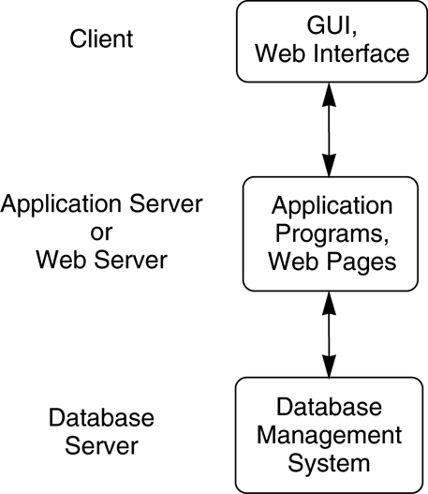
Logical three-tier client/server architecture

Slide 32
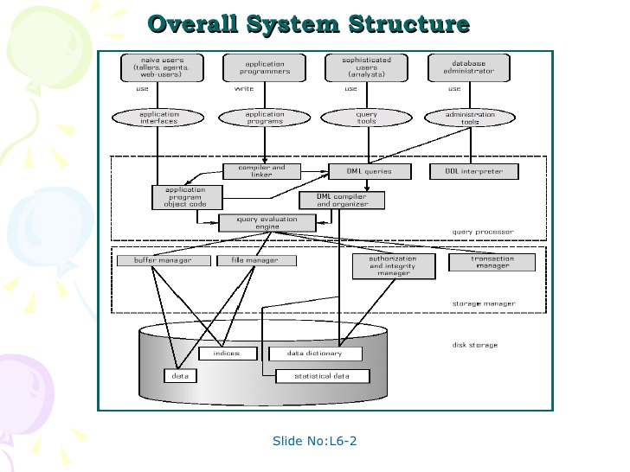

Slide 33
Query Processor:
The query processor will accept query from user and solves it by accessing the database.
Parts of Query processor:
DDL interpreter
This will interprets DDL statements and fetch the definitions in the data dictionary.
DML compiler
a. This will translates DML statements in a query language into low level instructions that the query evaluation engine understands.
b. A query can usually be translated into any of a number of alternative evaluation plans for same query result DML compiler will select best plan for query optimization.
Query evaluation engine
This engine will execute low-level instructions generated by the DML compiler on DBMS.

Slide 34
Storage Manager
A storage manager is a program module which acts like interface between the data stored in a database and the application programs and queries submitted to the system.
Thus, the storage manager is responsible for storing, retrieving and updating data in the database.
The storage manager components include:
Authorization and integrity manager: Checks for integrity constraints and authority of users to access data.
Transaction manager: Ensures that the database remains in a consistent state although there are system failures.
File manager: Manages the allocation of space on disk storage and the data structures used to represent information stored on disk.
Buffer manager: It is responsible for retrieving data from disk storage into main memory. It enables the database to handle data sizes that are much larger than the size of main memory.
Data structures implemented by storage manager.
Data files: Stored in the database itself.
Data dictionary: Stores metadata about the structure of the database.
Indices: Provide fast access to data items

